Slide 1

Sports Image Recognition Using TensorFlow classification
By Xin Zhang
Supervisor: Dr. Mariofanna Milanova
Dr. PeiYi Tang
Dr. Chia-Chu Chiang

Slide 2
Introduction
Objectives
Challenges
Sports Datasets
Implementation

Slide 3
Introduction
The majority of existing frameworks for action recognition consist of three main steps: feature extraction, dictionary learning to form a representation for a video based on the extracted features, and finally classification of the video using the representation.
Developing automatic methods for analyzing actions in videos are of particular importance for machine understanding of sports.
TensorFlow Is an open source software library for numerical computation using data-flow graphs .Convolutional neural network is the most popular techniques used in improving the accuracy of image classification.
Input Video Sports Action
Video Frames
Features Extraction
Action Classification
Output Action

Slide 4
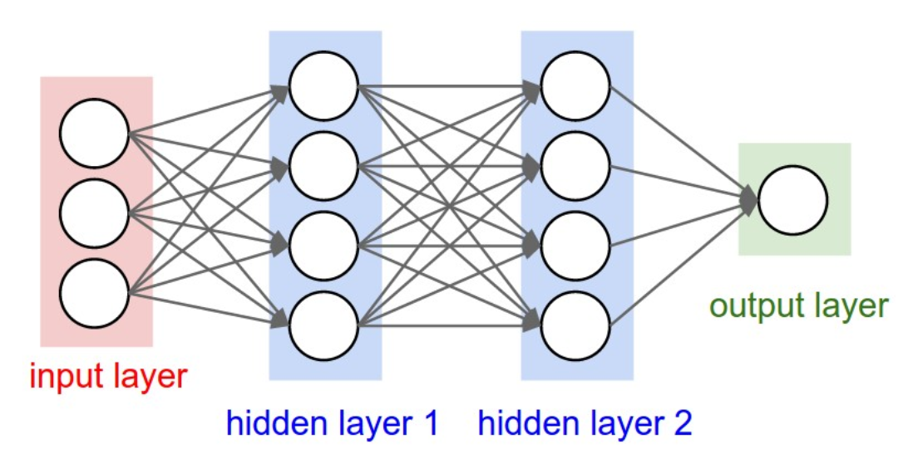
Neural Network
A computational model that works in a similar way to the neurons in the human brain. Each neuron takes an input, performs some operations then passes the output to the following neuron.

Slide 5
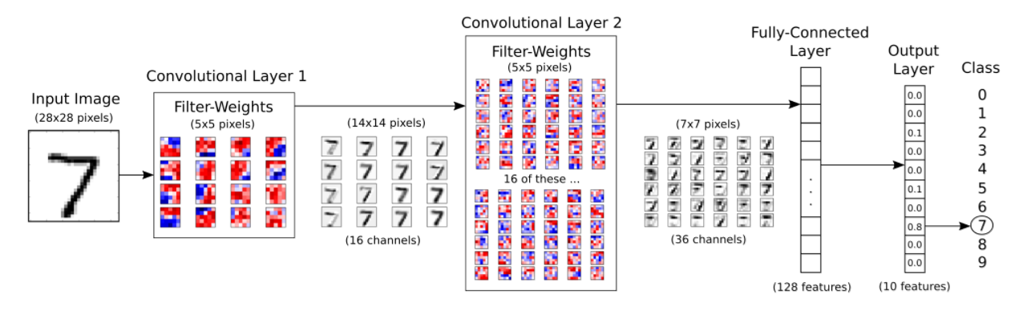
Convolutional Neural Network
The input image is processed in the first convolutional layer using the filter-weights. This results in 16 new images, one for each filter in the convolutional layer. The images are also down-sampled so the image resolution is decreased from 28x28 to 14x14.
These 16 smaller images are then processed in the second convolutional layer. We need filter-weights for each of these 16 channels, and we need filter-weights for each output channel of this layer.

Slide 6
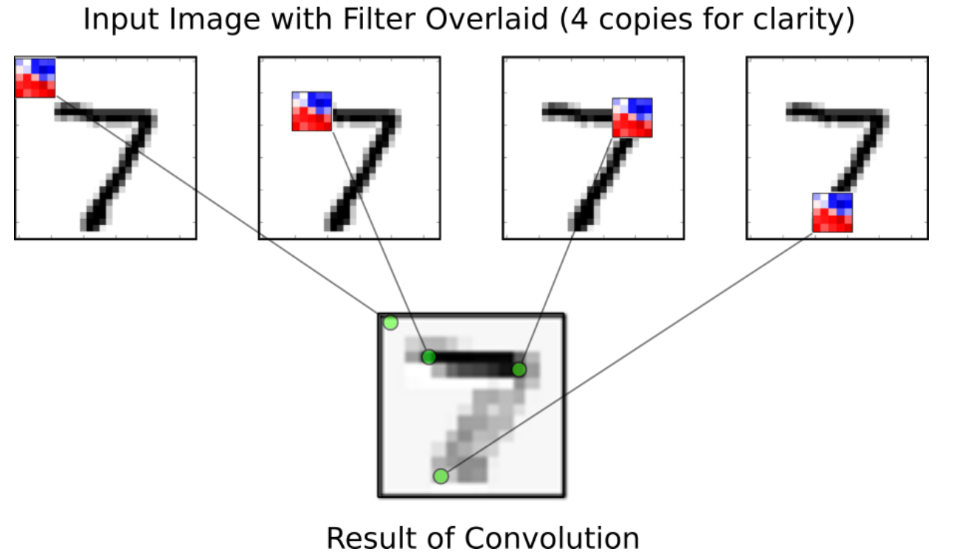
Convolutional Layer
For each position of the filter, the dot-product is being calculated between the filter and the image pixels under the filter, which results in a single pixel in the output image. So moving the filter across the entire input image results in a new image being generated.
The red filter-weights means that the filter has a positive reaction to black pixels in the input image, while blue pixels means the filter has a negative reaction to black pixels.
In this case it appears that the filter recognizes the horizontal line of the 7-digit, as can be seen from its stronger reaction to that line in the output image.

Slide 7
Objectives
A new real-time deep neural network model to training and learning of dataset samples to achieve the best network performance.
Improve the performance of the deep learning framework to reach a highest or optimal
promising accuracy.
Train and test the recognition system using video frames as 3D input.
Justify performance of the system using different datasets with various actions. That diversity gives the best efficiency of the system performance.

Slide 8
Challenges
Such as dealing with background clutter or the spatial complexity of the scene.
One person performs same action differently.
Same action is performed differently by different people
Typically attempt to segment the action utilizing cues based on the appearance, motion, or a combination of both
Background scene: Light, static or moving…..

Slide 9
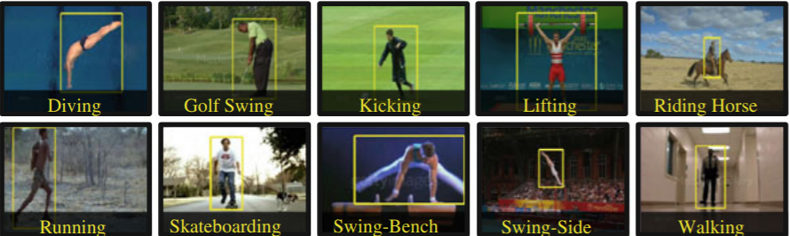
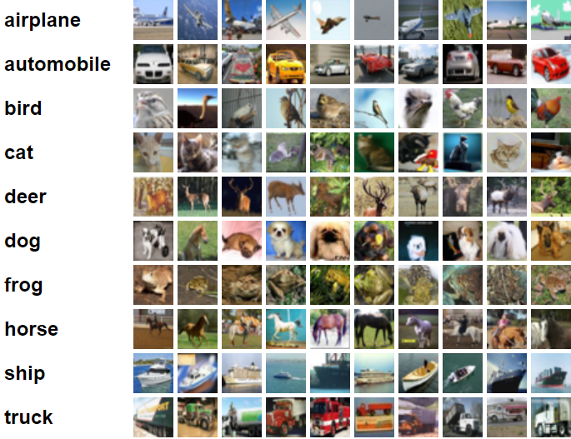
Datasets
UCF Sports Dataset
UCF Sports consists of various sports actions collected from broadcast television channels including ESPN and BBC.
CIFAR-10 Dataset
The CIFAR-10 dataset consists of 60000 32x32 color images in 10 classes, with 6000 images per class. There are 50000 training images and 10000 test images.

Slide 10
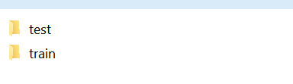
Implementation
Step 1: Convert video to frame. We can use some application such as FastStone photo resize
Step 2: Setup your python environment. such as the picture
Pandas// work with data as tables. Numpy//use number matrices
Step 3: Make two folders form dataset, one is call test, the other one is call train. The test fold you will randomly pick some pictures form train.
Step 4:Use FastStone photo resize make the size of all image’s
import time
import math
import random
import pandas as pd
import numpy as np
import matplotlib.pyplot as plt
import tensorflow as tf
import dataset import cv2

Slide 11
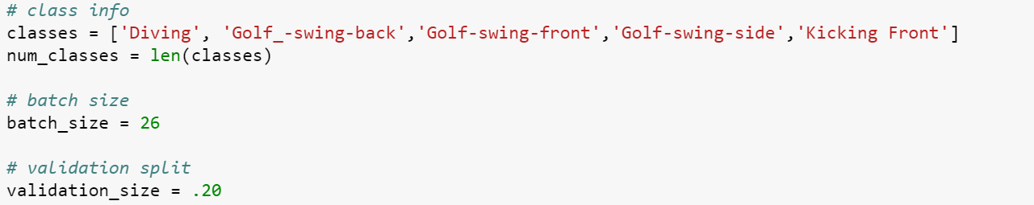
Implementation
Step 5: Load data
I have used images of UCF Sports Datasets but you could use any image folders on your computer which contain different kinds of objects. We divide our input data into 3 parts:
1.Training Data
2.Validation Data:20% images will be used for validation, These images are taken out of training data to calculate accuracy independently during the training process.

Slide 12
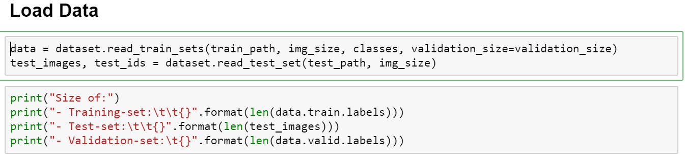
3.Test Set: Separate independent data for testing which has a lot of images.
After training, neural networks start working very well on the training data. For example, if you are training a classifier get training data from someone who takes all images with white backgrounds. It’s possible that your network works very well on this validation data-set, but if you try to run it on an image with a cluttered background, it will most likely fail.

Slide 13
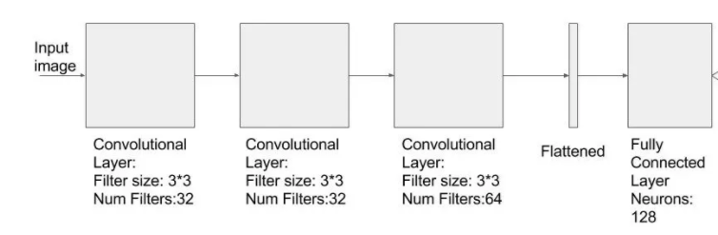
Implementation
Step 6: Building convolution layer in TensorFlow
Network that we will implement is smaller and simpler so that you can train this on your cpu as well. While training, images from the classes are fed to a convolutional layer which is followed by 2 more convolutional layers. After convolutional layers, we flatten the output and add two fully connected layer in the end. The second fully connected layer has outputs which represent the probability of an image being which sports.

Slide 14
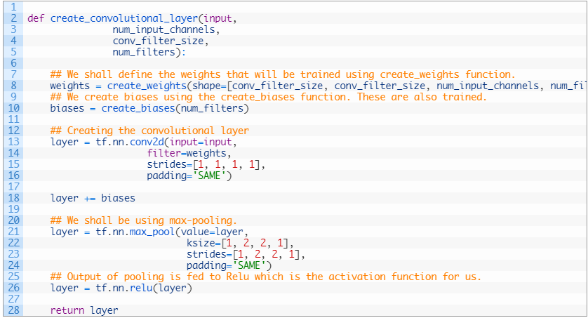
Implementation
This function creates a new convolutional layer in the computational graph for TensorFlow. Nothing is actually calculated here, we are just adding the mathematical formulas to the TensorFlow graph.
It is assumed that the input is a 4-dim tensor with the following dimensions:
Image number.
Y-axis of each image.
X-axis of each image.
Channels of each image.

Slide 15
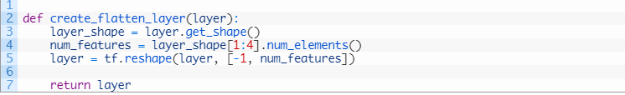
Implementation
Step 7. Flattening layer
The Output of a convolutional layer is a multi-dimensional Tensor. We want to convert this into a one-dimensional tensor. This is done in the Flattening layer. We can use the reshape operation to create a single dimensional tensor as defined below:

Slide 16
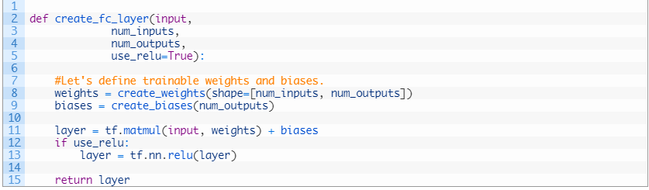
Implementation
Step 8. Fully connected layer
Just like any other layer, we declare weights and biases as random normal distributions. In fully connected layer, we take all the inputs, operation on it. Also sometimes you would want to add a non-linearity(RELU) to it.
After this step, we have finished defining the building blocks of the network.

Slide 17

Implementation
Step 9. Placeholders and input
Placeholder variables serve as the input to the TensorFlow computational graph that we may change each time we execute the graph. We call this feeding the placeholder variables and it is demonstrated further below.
placeholder that will hold the input training images. All the input images are read in dataset.py file and resized to 128 x 128 x 3 size. Input placeholder x is created in the shape of [None, 128, 128, 3]. The first dimension being None means you can pass any number of images to it.

Slide 18
Implementation
Step 10. Predictions
you can get the probability of each class by applying softmax to the output of fully connected layer.
y_pred = tf.nn.softmax(layer_fc2,name="y_pred")
y_pred contains the predicted probability of each class for each input image. The class having higher probability is the prediction of the network.
y_pred_cls = tf.argmax(y_pred, dimension=1)
The cost that will be minimized to reach the optimum value of weights. We will use a simple cost that will be calculated using a Tensorflow function softmax_cross_entropy_with_logits which takes the output of last fully connected layer and actual labels to calculate cross_entropy whose average will give us the cost.
In Neural networks. The softmax function is often used in the final layer of a neural network-based classifier. Such networks are commonly trained under a log loss (or cross-entropy) regime, giving a non-linear variant of multinomial logistic regression.

Slide 19
Implementation
Step 11. Optimization
we have a cost measure that must be minimized, we can then create an optimizer Tensorflow implements most of the optimization functions. We shall use AdamOptimizer for gradient calculation and weight optimization.
optimizer = tf.train.AdamOptimizer(learning_rate=1e-4).minimize(cost)
But we run optimizer operation inside session.run(), in order to calculate the value of cost, the whole network will have to be run and we will pass the training images. Does that make sense? Think about, what variable would you need to calculate cost and keep going up in the code). Training images are passed in a batch of 26(batch_size) in each iteration.

Slide 20
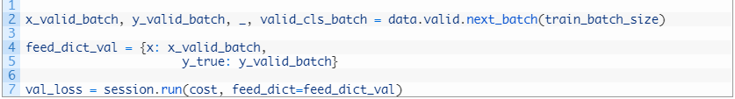
Implementation
where next_batch is a simple python function in dataset.py file that returns the next 26 images to be passed for training. Similarly, we pass the validation batch of images independently to in another session.run() call
We can calculate the validation accuracy by passing accuracy in session.run() and providing validation images in a feed_dict. And we also report the accuracy for the training images.
val_acc = session.run(accuracy,feed_dict=feed_dict_validate)
acc = session.run(accuracy, feed_dict=feed_dict_train)

Slide 21
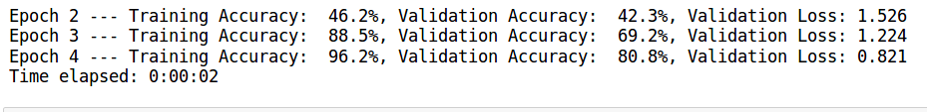
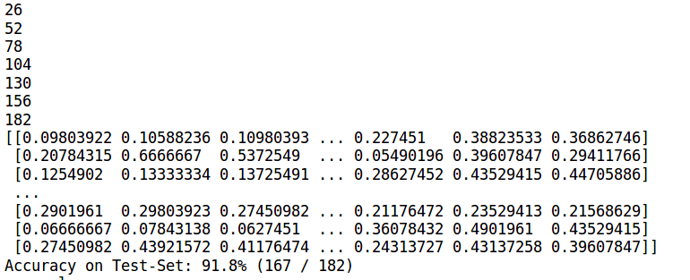
Implementation
As, training images along with labels are used for training, so in general training accuracy will be higher than validation. We report training accuracy to know that we are at least moving in the right direction and are at least improving accuracy in the training dataset. After each Epoch, we report the accuracy numbers and save the model using saver object in Tensorflow.

Slide 22
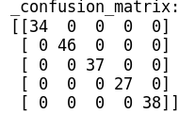
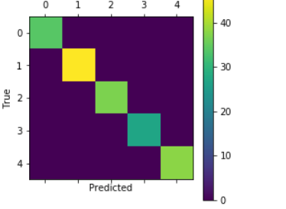
Implementation
Step 12. Get Result
Confusion matrix: is a table that is often used to describe the performance of a classification model (or "classifier") on a set of test data.
Each row of the matrix represents the instances in a predicted class while each column represents the instances in an actual class (or vice versa)

Slide 23
Reference
1.http://cv-tricks.com/tensorflow-tutorial/training-convolutional-neural-network-for-image-classification/
2. https://github.com/Hvass-Labs/TensorFlow-Tutorials/blob/master/02_Convolutional_Neural_Network.ipynb
3. https://www.mathworks.com/help/nnet/ref/plotconfusion.html

Slide 24
Thank You

